Slide 1

























Quantum Emulator Architecture
*The Quantum Emulator shown has two 2-Order Quantum Cores (Emulates 4 Qubits and 2 Quantum Gates per cycle). The architecture shown emulates 32 Qubits (assuming enough storage space) and has 16 bits to store each Quantum State (8 bits for the real number and 8 bits for the imaginary number).
Quantum Emulator
$$Flags$$
Quantum Gates
Quantum Processing Unit
$$QS7$$
$$Flags$$
$$QS6$$
FSM
$$QS5$$
$$Start$$
QC
QC
$$QS4$$
$$QS3$$
$$Reset$$
$$QS2$$
$$QS1$$
$$QS0$$
$$Gate Select$$
Data Memory System
$$Instruction$$
$$R_{Inst}$$
$$Add7$$
$$Add6$$
Address Generator
$$Add5$$
$$Add4$$
$$Add3$$
$$Add2$$
$$Add1$$
$$Add0$$
$$R_{Inst}$$
$$End$$
$$=$$

Slide 2


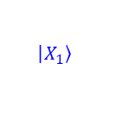



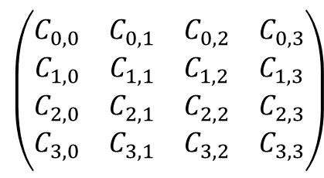
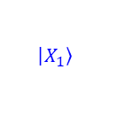

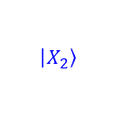

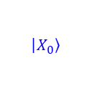






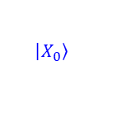






$2$-Order Quantum Cores
$$\left|\left.X_{0}\right\rangle \right.$$
$$\left|\left.X_{1}\right\rangle \right.$$
$$\left|\left.X_{2}\right\rangle \right.$$
$$\left|\left.X_{3}\right\rangle \right.$$
$$R_{in0}$$
$$R_{in1}$$
$$R_{in3}$$
$$R_{in3}$$
$$C_{1,0}$$
$$C_{1,1}$$
$$C_{1,3}$$
$$C_{1,3}$$
$$QS_{1}$$
$$R_{out0}$$
$$\left|\left.X_{0}\right\rangle \right.$$
$$C_{1,0}$$
$$C_{1,1}$$
$$C_{1,3}$$
$$C_{1,3}$$
$$\left(\begin{matrix}\begin{matrix}C_{0,0} & C_{0,1} \\ C_{1,0} & C_{1,1}\end{matrix} & \begin{matrix}C_{0,2} & C_{0,3} \\ C_{1,2} & C_{1,3}\end{matrix} \\ \begin{matrix}C_{2,0} & C_{2,1} \\ C_{3,0} & C_{3,1}\end{matrix} & \begin{matrix}C_{2,2} & C_{2,3} \\ C_{3,2} & C_{3,3}\end{matrix}\end{matrix}\right)$$
$$QS_{1}$$
$$R_{out1}$$
$$\left|\left.X_{1}\right\rangle \right.$$
$$C_{1,0}$$
$$C_{1,1}$$
$$C_{1,3}$$
$$C_{1,3}$$
$$QS_{1}$$
$$R_{out1}$$
$$\left|\left.X_{2}\right\rangle \right.$$
$$C_{1,0}$$
$$C_{1,1}$$
$$C_{1,3}$$
$$C_{1,3}$$
*$C_{i,i}$ are the quantum gates coefficients.
$$QS_{1}$$
$$R_{out1}$$
$$\left|\left.X_{3}\right\rangle \right.$$
Quantum Core

Slide 3










































Guantum Gates Coefficients
These are implemented with LUTs, which store the most commonly used quantum gates. The outputs of these LUTs are directly connected to all the Quantum Cores.
$$I_{1,1}$$
$$I_{1,2}$$
$$I_{{1,2}^{k}}$$
$$X_{1,1}$$
$$X_{1,2}$$
$$X_{{1,2}^{k}}$$
$$Z_{1,1}$$
$$C_{0,0}$$
$$Z_{1,2}$$
$$C_{0,1}$$
$$Z_{{1,2}^{k}}$$
$$C_{0,3}$$
$$H_{1,1}$$
$$H_{1,2}$$
$$H_{{1,2}^{k}}$$
$$S_{1,1}$$
$$S_{1,2}$$
$$S_{{1,2}^{k}}$$
$$T_{1,1}$$
$$T_{1,2}$$
$$T_{{1,2}^{k}}$$
$$I_{2^{k},1}$$
$$I_{2^{k},2}$$
$$I_{2^{k},2^{k}}$$
$$X_{2^{k},1}$$
$$X_{2^{k},2}$$
$$X_{2^{k},2^{k}}$$
$$Z_{2^{k},1}$$
$$C_{3,0}$$
$$Z_{2^{k},2}$$
$$C_{3,1}$$
$$Z_{2^{k},2^{k}}$$
$${C_{3,3}}_{ }$$
$$H_{2^{k},1}$$
$$H_{2^{k},2}$$
$$H_{2^{k},2^{k}}$$
$$S_{2^{k},1}$$
$$S_{2^{k},2}$$
$$S_{2^{k},2^{k}}$$
$$T_{2^{k},1}$$
$$T_{2^{k},2}$$
$$T_{2^{k},2^{k}}$$

Slide 4




















AddrGen
The address Generator inputs are what qubits are gonna be processed, and the outputs are the addresses where the data to be processed are. The quantity of inputs and outputs depends on the order of the core and the quantity of the cores.
$$no. of inputs=Order$$
$$no. of outputs=2^{Order}∗no. of cores$$
$$R_{s}$$
$$1$$
$$1$$
OR
$$R_{0}$$
$$s0$$
XOR
$$Add0$$
XOR
$$Add4$$
XOR
$$Add1$$
XOR
$$Add5$$
$$R_{1}$$
$$s1$$
XOR
$$Add2$$
XOR
$$Add6$$
$$R_{2}$$
XOR
$$Add3$$
XOR
$$Add7$$
$$c1$$
$$R_{3}$$
$$s0$$
$$s1$$
$$c1$$

